Slide 1
Cascading Style Sheets
Presented by
Sobia Noor

Slide 2
HTML Styling
Every HTML element has a default style (background color is white and text color is black).
Changing the default style of an HTML element, can be done with the style attribute.

Slide 3
Styling HTML with CSS
CSS stands for Cascading Style Sheets
It style the HTML files
Styling can be added to HTML elements in 3 ways:
Inline - using a style attribute in HTML elements
Internal - using a <style> element in the HTML <head> section
External - using one or more external CSS files

Slide 4
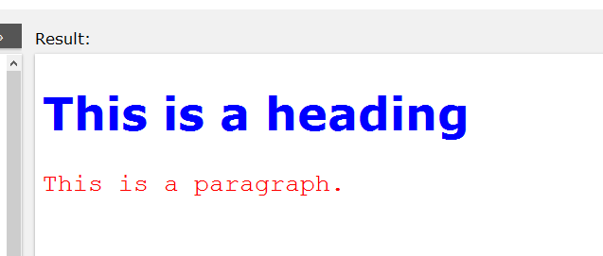
CSS Fonts
Output:
<!DOCTYPE html> <html> <head> <style> h1 { color:blue; font-family:verdana; font-size:300%; } p { color:red; font-family:courier; font-size:160%; } </style> </head> <body> <h1>This is a heading</h1> <p>This is a paragraph.</p> </body> </html>

Slide 5
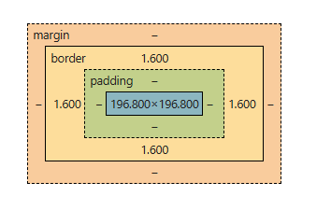
CSS Box Model
CSS Box Model
CSS border property defines a visible border around an HTML element:

Slide 6
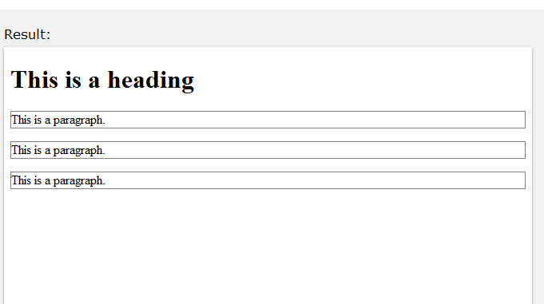
CSS Box Model
Output:
CSS Box Model
CSS border property defines a visible border around an HTML element:
Example:
p { border:1px solid black; }
Borde-style:
dotted - Defines a dotted border
dashed - Defines a dashed border
solid - Defines a solid border
double - Defines a double border
groove - Defines a 3D grooved border.
None- Defines no border

Slide 7
CSS Box Model
Output:
Border-style:
dotted - Defines a dotted border
dashed - Defines a dashed border
solid - Defines a solid border
double - Defines a double border
groove - Defines a 3D grooved border.
None- Defines no border
Border sides
border-top-style: dotted;
border-right-style: solid;
border-bottom-style: dotted;
border-left-style: solid;

Slide 8
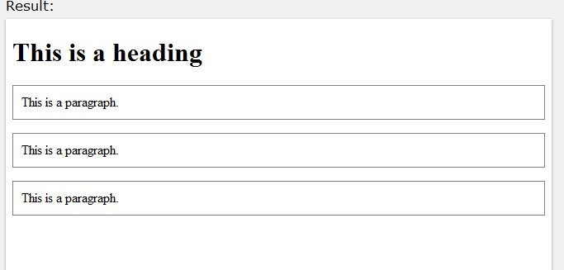
CSS padding
Output:
The CSS padding property defines a padding (space) inside the border:
Example:
p { border:1px solid black; padding:10px; }
Padding sides
padding-top: 50px;
padding-right: 30px;
padding-bottom: 50px;
padding-left: 80px;

Slide 9
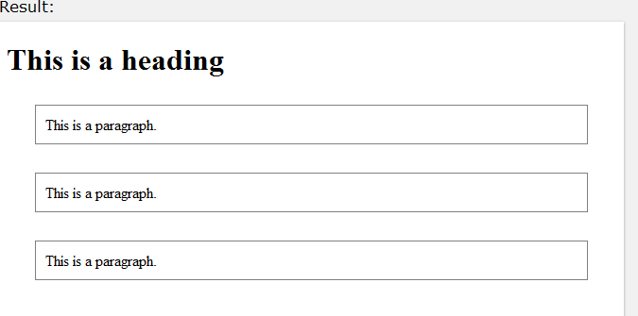
CSS margin
Output:
The CSS margin property defines a margin (space) outside the border:
Example
p { border:1px solid black; padding:10px; margin:30px; }

Slide 10

Attributes
id Attribute:
All the examples above use CSS to style HTML elements in a general way.
To define a special style for one special element, first add an id attribute to the element:
Example:
<p id="p01">I am different</p>
then define a different style for the (identified) element.
Example:
p#p01 { color:blue; }
Output:

Slide 11
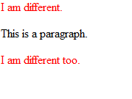
class Attribute
To define a style for a special type (class) of elements, add a class attribute to the element:
Example:
<p class="error">I am different</p>
Now you can define a different style for all elements with the specified class:
Example:
p.error { color:red; }
Output:

